Slide 1



Capstone Project

Slide 2
Presentation content
Problem statement
Brief about the project
Wireframe
Demo of the project
Technologies used
What was the most difficult part of the project
What was your favorite part of the project
What are the new things you learned creating this application

Slide 3

Parts of the projects
Add
Read
Edit
Delete
The user can’t used it without sign up
Athkar
Quran
Qibla
Setting
The user can use it without sign up

Slide 4
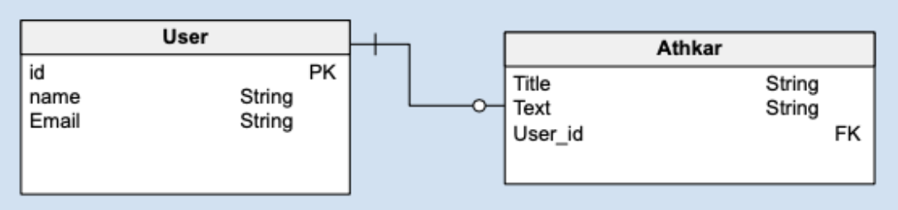
Entity Relationship Diagram

Slide 5
AS user I can register
AS user I can login
AS user I can read the daily athkar
AS User I can Create
AS User I can Update
AS User I can delete
AS User I can copy
AS User I can share athkar
AS User I can use sebha(tsbeeh)
AS User I can Activate night mode
// Extra
AS User I can Change the language
AS user I can read the Qur’an, and listen to some reciters
AS user I can determine the qiblah
AS user I can Add settings through which the user can add an alarm to Athkar him of the remembrances
README.md

Slide 6
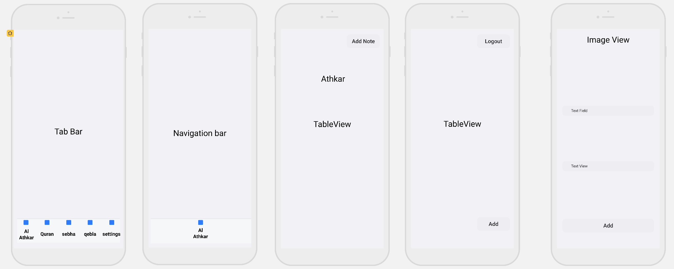
Wireframe

Slide 7
THANK YOU

